Slide 1
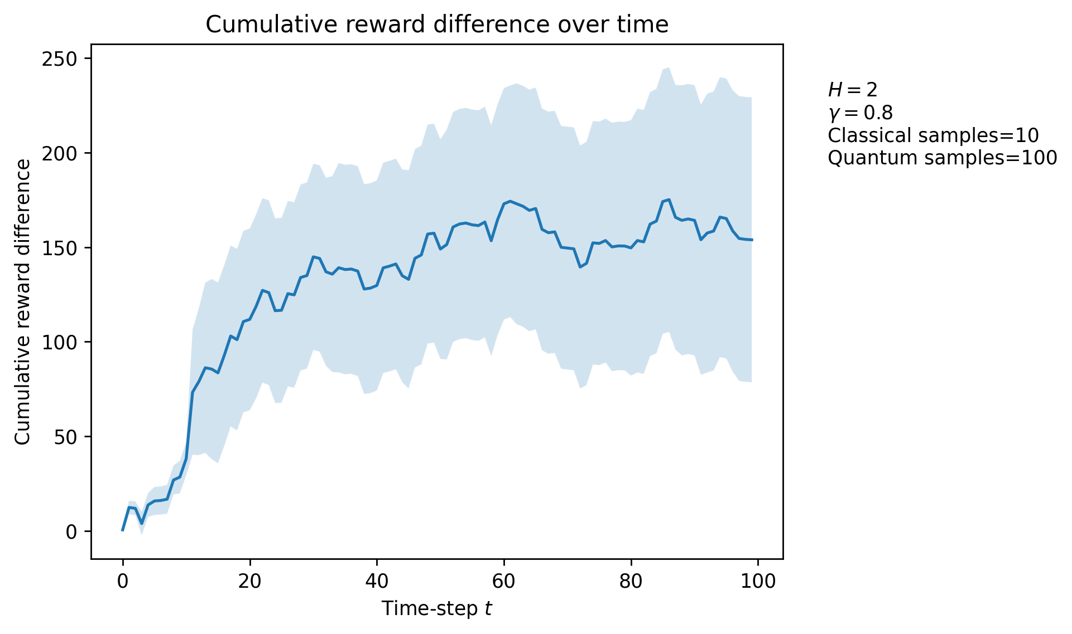
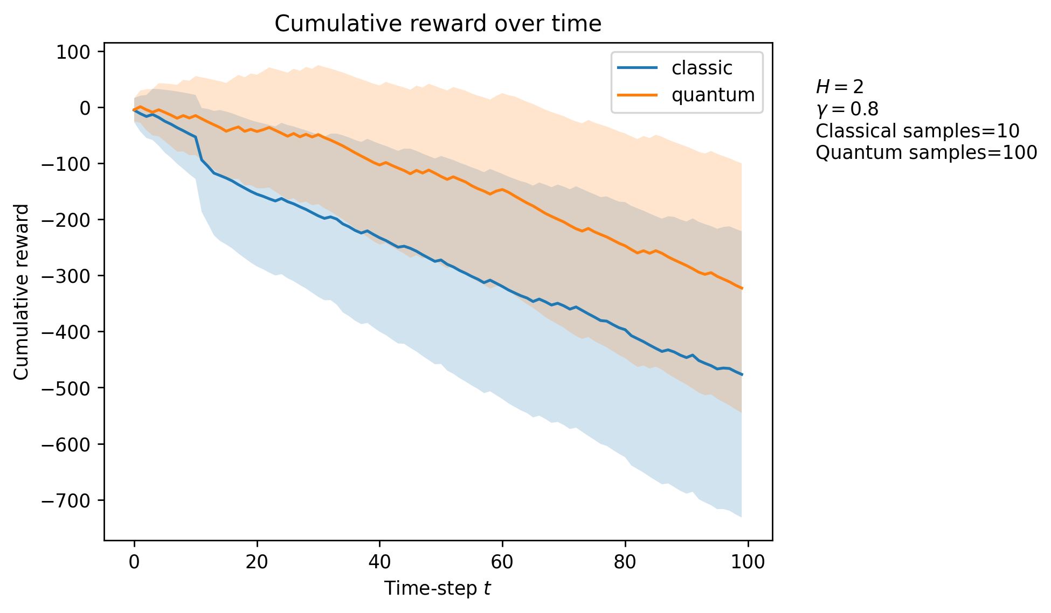
Tiger Problem

Slide 2
Option 1
Input metric: total samples.
We want N samples
2 loops: 1 to generate samples, 1 for rejection part
Dismiss cost of generating samples (quantum advantage)
Reinsert cost using maximal theoretical calculations
Classical case:
Quantum case:
Standard sampling algorithm
Sample from quantum circuit using QSearch

Slide 3
Option 1.3
Option 1.2
Same, but change quantum case.
Calculate evidence probability to obtain ideal m, OR
Perform QAE to obtain estimate of ideal m, OR
Do at random
Replace QSearch loop for each sample by single (optimal) quantum circuit
Use classical method (binomial noise) to simulate quantum since quantum properties aren’t used anyway. Use exact or approximate P(e) and use binomial sampling to reintroduce shot noise

Slide 4
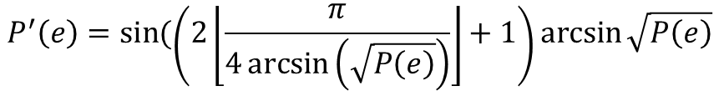
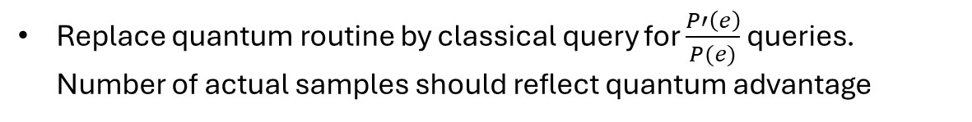
Option 2
Cost metric: number of queries. Variable number of effective samples <= Nq due to rejection
Calculate evidence probability to obtain ideal m, OR
Perform QAE to obtain estimate of ideal m,
P’(e) is optimal amplified acceptance probability. Can be calculated as:
$$P^{′}\left(e\right)=\sin{(\left(2\left\lfloor \frac{π}{4\arcsin\left(\sqrt{P\left(e\right)}\right)}\right\rfloor +1\right)\arcsin{\sqrt{P\left(e\right)}}}$$
$$\frac{P′\left(e\right)}{P(e)}=quantum advantage ratio$$
Replace quantum routine by classical query for $\frac{P′\left(e\right)}{P(e)}$ queries. Number of actual samples should reflect quantum advantage

Slide 5
Option 2
Possible problems
P(e) calculation not necessarily efficient for all cases?
Different stochasticity due to fraction + rounding error. But should be same asymptotical behavior

Slide 6
Option 2
Advantages
More meaningful numerical analysis
Less for loops: holding number of queries constant rather than number of post-rejection-sampling samples makes the number of iterations constant -> parallelization potential.
Can that be fully exploited? (direct sampling algorithm)

Slide 7
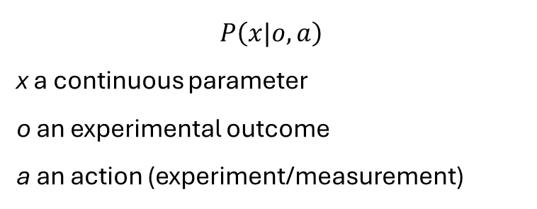
Sensor model
“Reward has no QAA advantage because the conditional distribution is marginalized over action a, state b: root nodes”
What if there’s an implicit dependence of expected reward in predictive Bayesian updates by means of a and b?
$$P\left(x|o,a\right)$$
x a continuous parameter
o an experimental outcome
a an action (experiment/measurement)

Slide 8
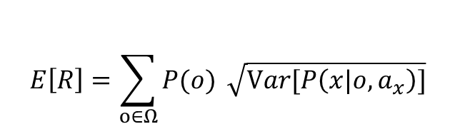


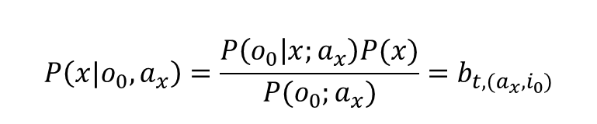



Sensor model
$$P\left(x|o_{0},a_{x}\right)=\frac{P\left(o_{0} | x;a_{x}\right)P(x)}{P(o_{0};a_{x})}=b_{t,(a_{x}, i_{0})}$$
$$P\left(o_{0}\right)$$
$$b_{t}$$
$$…$$
$$P\left(x|o_{|Ω|},a_{x}\right)$$
$$P\left(o_{|Ω|}\right)$$
$$E\left[R\right]=\sum_{o∈Ω}{P(o)} \sqrt{Var[P\left(x|o,a_{x}\right)]}$$
requires Bayes update -> could benefit from quantum advantage in extra steps (exponential in the lookahead)
Problem: calculating P(e) for continuous variables

